Slide 1
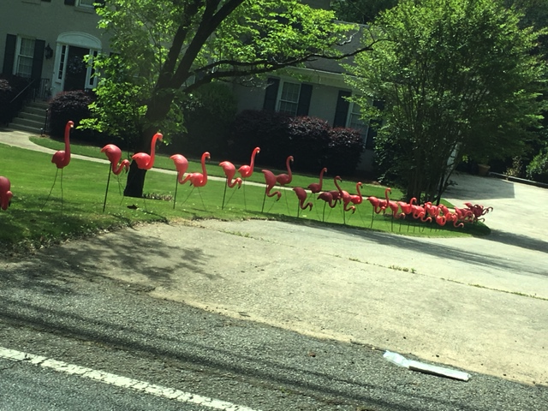
ACC Fence Design Guidelines
HSB Board Review
April 20, 2016 Meeting
Bill Childs

Slide 2
Existing Fence Guidelines Are Unclear
The purpose of this discussion is to recommend we increase specificity of guidelines for fences to our ACC Design Guide.
Residents regularly question us based on existing guidelines being unclear.
Homeowners complain about approved fences not meeting design guidelines.
Guidelines are clear on most points, but we could be more specific on a few items.

Slide 3
Copy of Current ACC Fence Guidelines
Fences should normally be four to five feet with an open design, such as split rail. No chain link fences are allowed. When the fence is enclosing a pool, it has to be five feet to comply with Fulton County ordinances. No fences are allowed in front yards. Fences should be linked to the back of the house. If the fence can be seen from the street, landscaping must be installed in front of the fence between it and the street. Besides wooden fences, wrought iron and aluminum fences that look like wrought iron may be used. Fences must be open design with the space between pickets or poles being equal to or greater than the width of the picket or pole.

Slide 4
Fence Guidelines to Revise
Fence Guideline | Unclear? | Recommend change
“Normally 4-5 feet” | What is normal? What about more or less than?
“Open design such as split rail”. | What does open mean? Are there some we approve and some we don’t? (i.e. split rail)
“Space between pickets or poles being equal to or greater than width of the picket or pole” | Do we measure? Some designs meet guidelines but look “closed”. Is the picket width the individual pickets or the support poles?
Covenants state: C (13) “the open space must be equal to or greater than the closed space in the fence surface." | Does it add clarity or does it complicate the ACC Design Guide? Do we need guides in both places?

Slide 5
Fence Guidelines to Revise
Fence Guideline | Unclear? | Recommend change
City of Roswell ordinance: The “finished" side must be on the outside of the fence (facing neighbors). | Not in current ACC Design Guide.
“Besides wooden fences, wrought iron and aluminum fences that look like wrought iron may be used” | Do we specify and encourage powder-coated aluminum styles?

Slide 6
Fence Height
Recommend we simply state that the maximum height is 5 feet.
If a fence in a backyard faces a major road (Holcomb Br), apartment complex, storage facility, etc., should we allow a height greater than 5 feet? (Recommend Board approval above 5 feet.)

Slide 7
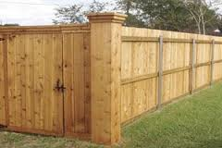
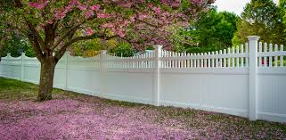
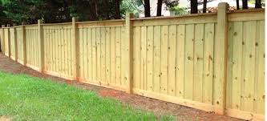
Fence Design – Open vs. Closed Closed Designs Not Allowed
Common denominator: No light visible between pickets at any height or angle.

Slide 8
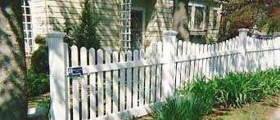
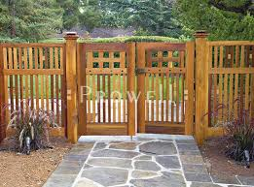
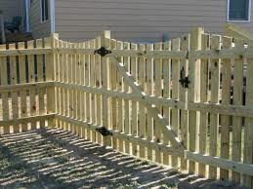
Fence Design – Open vs. Closed Open Designs in Question
Space between pickets less than width of pole

Slide 9
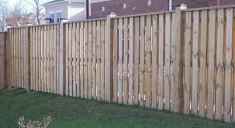
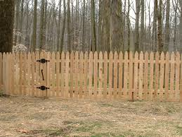
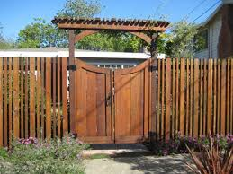
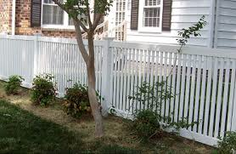
Fence Design – Open vs. Closed Open Designs in Question
Space between pickets less than width of pole

Slide 10
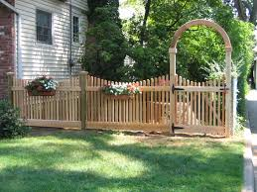
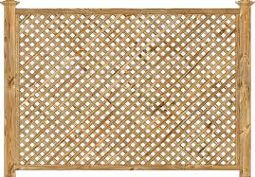
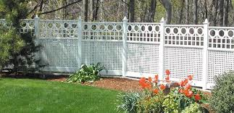
Fence Design – Open vs. Closed Open Designs in Question
Space between pickets less than width of pole

Slide 11
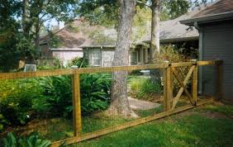
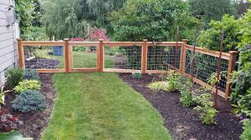
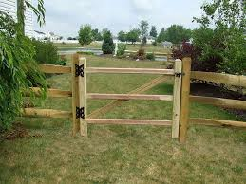
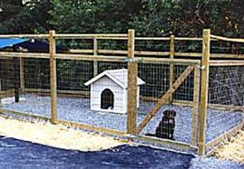
Open Fence Designs Any Design Concerns? (They meet current design criteria)

Slide 12
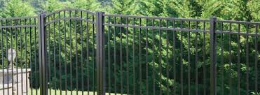
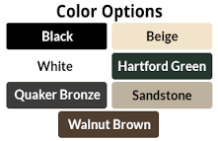
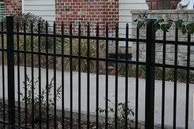
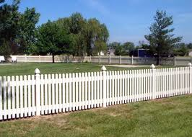
Powder Coated Aluminum Material

Slide 13
Fence Materials Update
Should we specify or emphasize “powder coated” aluminum?
Powder coating is a completely dry finishing process. Finely ground particles of pigment and resin are electro statically charged and sprayed onto the electrically grounded aluminum alloy and then oven-cured so that the particles adhere until melted and fused into a solid coating. Unlike liquid paint, no solvents are used, so only negligible amounts of VOCs*, if any, are released into the air. Unused or over sprayed powder can be recovered, so any waste is minimal. This efficient process helps keep costs down and serves to maximize product value.
* Volatile Organic Compounds

Slide 14
Fence Guidelines to Revise
Fence Guideline | Unclear? | Recommend change
“Normally 4-5 feet” | What is normal? What about more or less than? | A maximum of 5 feet Board approval above 5’
“Open design such as split rail”. | What does open mean? Are there some we approve and some we don’t? (i.e. split rail) | Must be visible light between pickets & posts at any height (no divided fences) or angle.
“Space between pickets or poles being equal to or greater than width of the picket or pole” | Do we measure? Some designs meet guidelines but look “closed”. Is the picket width the individual pickets or the support poles? | We specify a minimum number of inches of space for visible light between pickets. (i.e. 4 inches)
Covenants state: C (13) “the guideline is the open space must be equal to or greater than the closed space in the fence surface." | Does it add clarity or does it complicate the ACC Design Guide? Do we need guides in both places? | Recommend one version maintained in ACC Design Guide.

Slide 15
Fence Guidelines to Revise
Fence Guideline | Unclear? | Recommend change
City of Roswell ordinance. The “finished" side must be on the outside of the fence (facing neighbors) | Not in current ACC Design Guide. | Add to Design Guide.
Besides wooden fences, wrought iron and aluminum fences that look like wrought iron may be used | Do we encourage powder-coated aluminum styles?

Slide 16
Summary/ Next Steps
Agree on revision specifics
Bill to draft sentences to ACC Design Guide and route to board for final review

