Slide 1
ACC Flag Pole Guidelines
HSB Board Review
April 20, 2016 Meeting
Bill Childs

Slide 2
No HOA Guidelines Exist for Flag Poles
The purpose of this discussion is to recommend we add guidelines for flag poles to our ACC Design Guide and to provide options for board consideration.
No guidelines exist today, yet we get applications for approval each year. Several homes have flag poles.
There are types and sizes of poles, fixed to home and free standing.
There are flag sizes and types to consider.
We do not believe the ACC can/ should govern flag type, though HOA may want to address at later date.

Slide 3
HSB HOA Flag Pole Guidelines
Residential poles are between 15’ and 25’, standard being 20’.
Aluminum or fiberglass
Multi-colored poles
In-ground
Sectional or telescoping
Recommend:
20ft maximum residential pole.
Commercial grade aluminum or
Fiberglass.
Can be sectional
Colors: Bronze, Nickel, Clear, Black
(do not recommend black)

Slide 4
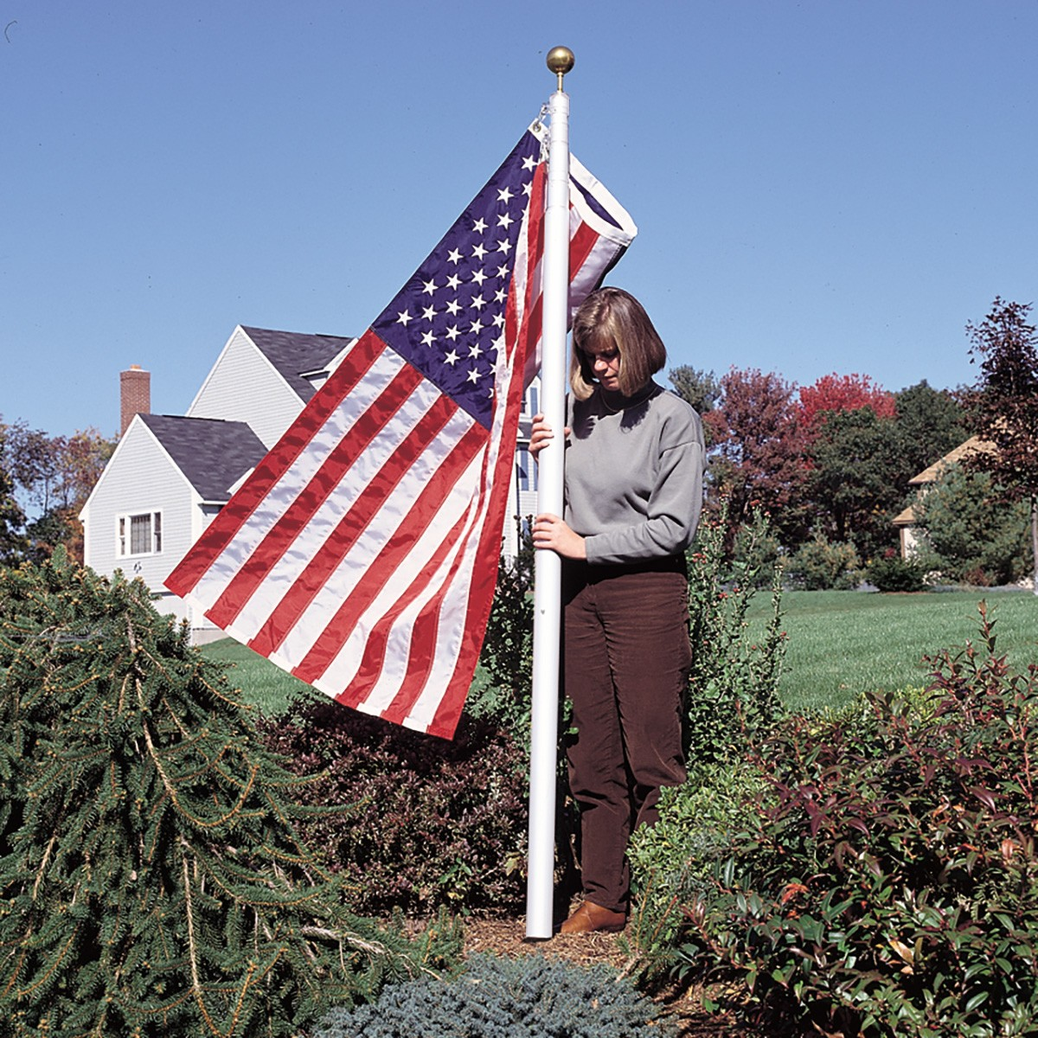
Residential Flag Pole – Possible Option
Telescoping residential pole.
Aluminum
Max 20 foot variety
Silver, bronze, white pole colors
Easier to put up and remove.

Slide 5
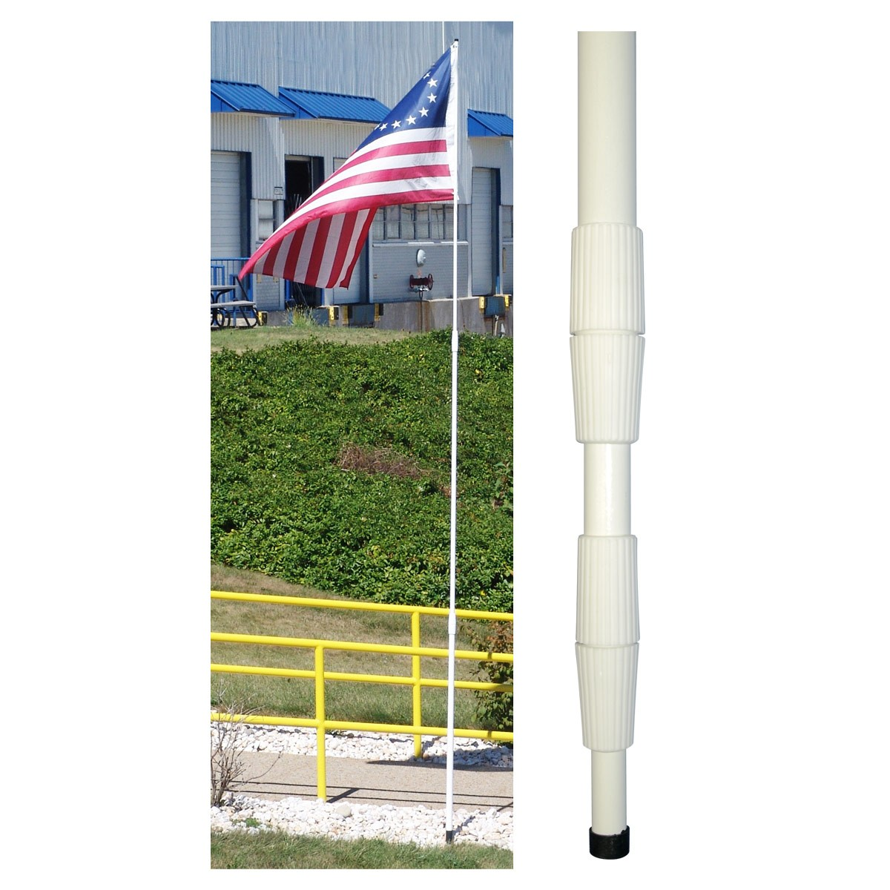
Flag Pole - Not Recommended
Telescoping residential pole.
Fiberglass
16 and 21 foot varieties
Looks cheap.

Slide 6
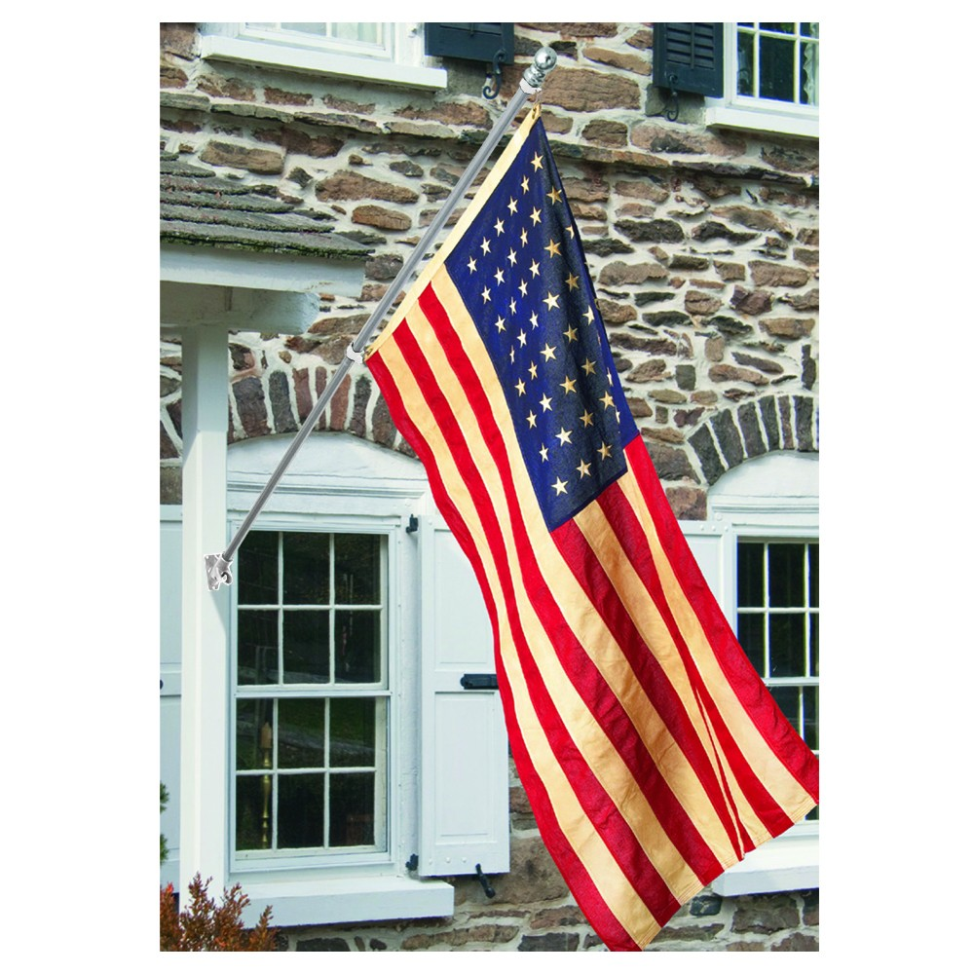
Wall Mounted Poles – Add to HOA Guidelines?
Sectional or telescoping residential pole.
Steel, fiberglass, aluminum
Up to 8 ft.
Mounts to home exterior
Recommend we do not control in guidelines since they do not impact look of home and usually only bracket shows when flag is not flown.

Slide 7
Flag Size & Type
Size: recommend 3’ x 5’ standard for maximum of a 20 ft pole.
Other size used 4’ x 6’ (do we allow)?
Flag type: Need legal counsel on what HOA has the right to enforce. Recommend this be a covenant review/ regulation vs. ACC committee.

Slide 8
Summary/ Next Steps
Recommend we add flag pole guidelines
Address free-standing poles not poles attached to home
Pole type & size: in-ground, sectional, commercial grade aluminum or fiberglass, 20’ maximum. Telescoping?
Flag size: 3x5, 4x6 maximum
Next step: Bill to draft paragraph to add to ACC Design Guide and route to board for final review

